Slide 1
Miniproject 4: Banking Clientele Segmentation
Niklas Bergen
September 2, 2021
Notes:
Nik
Zain’s comments on Miniproject 3:
Analyse dataset for bias (e.g. more male data than female) and pick equal amount of data
Anurag’s comments on Miniproject 2:
Real-life data science projects typically are at least 3 months
No code at all, or screenshots from Jupyter labs
Don’t make your audience work for your visualizations
Evaluate presentation from this perspective: “you are an owner of a company, and somebody presents you this presentation”.
Focus on the big picture and the business problems you are solving. (How does the business earn money?)
Practice talking to non-technical audience (how to explain API to a 5 year-old)

Slide 2
Outline
Objective
Workflow
Methods Used
Results
Challenges

Slide 3





Objective
Automate loan approval process
Self-employed
High Loan, Short Term
Post-Secondary Graduate
No credit history
Notes:
Not only automate it, but deploy to cloud.
Approval/denial factors are hypotheses!

Slide 4
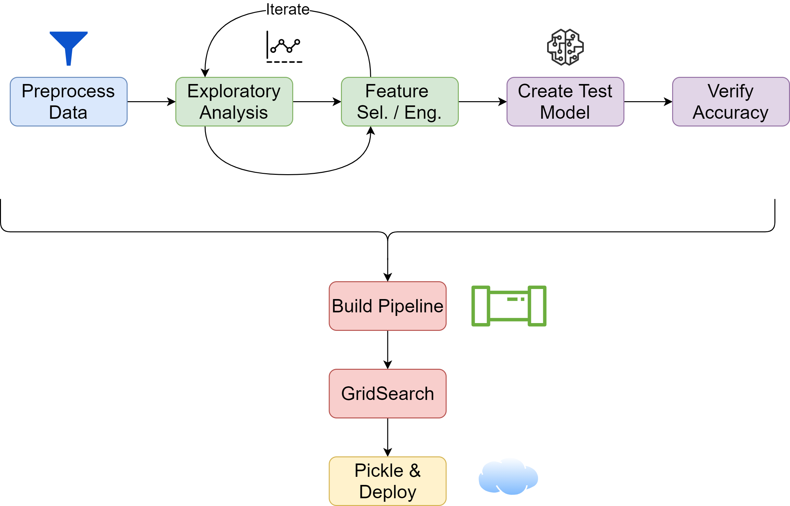
Workflow

Slide 5





Methods Used
RidgeClassifier
RandomForestClassifier
GradientBoostingClassifier
Primary Tools
Packages

Slide 6
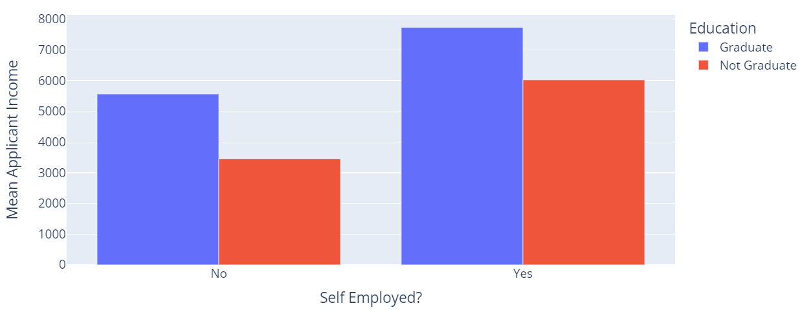
Results
Exploratory analysis:
Insights
Certain factors have a high influence on applicant income
Applicants should be required to provide more information

Slide 7
Results
Based on demographics:
Insights
Income is skewed based on gender
Could have special offers for women to increase business
Extend interest free period on credit cards
Target long-term plans for clients with kids

Slide 8
Results
Based on banking habits:
Insights
Target checking users to create a savings account
Target avid credit card users with credit limit increase
MinMax, KMeans, n = 4

Slide 9
Challenges
Adding engineered features into pipeline
Pipeline debugging
Code reusability
Notes:
Nik
- Code reusability: code developed during pre-pipeline stage needed a fair amount of rework before using in pipeline

